Slide 1
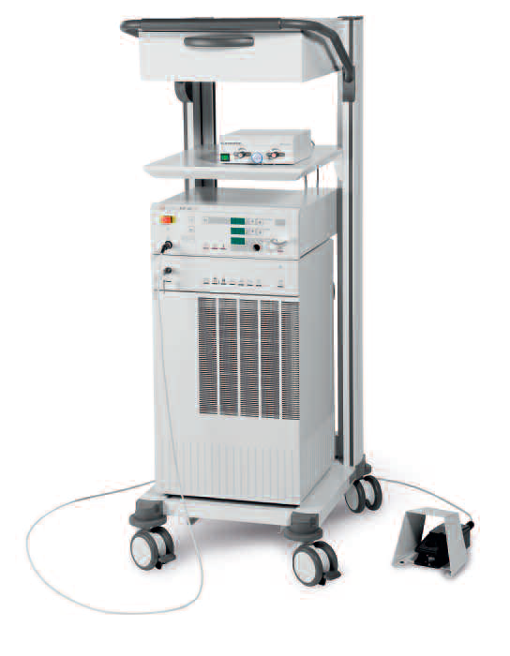
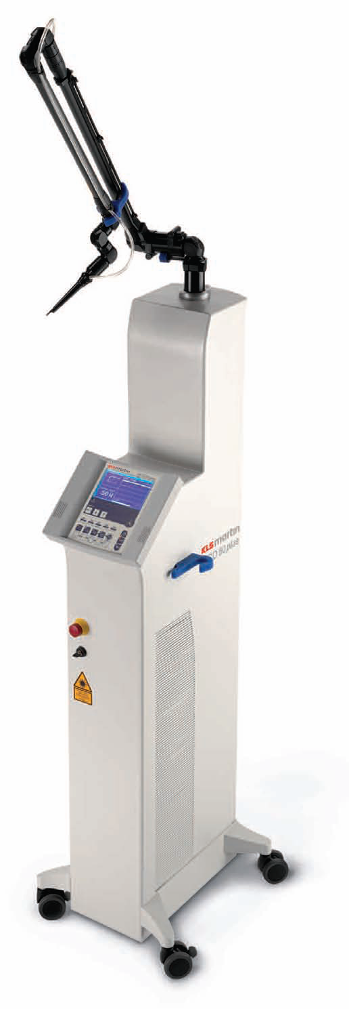
MEDICAL LASER SYSTEMS
Dr. Lutfi Ghulam Awazli
Institute of laser for postgraduate studies
University of Baghdad

Slide 2
Laser physics
and
Principle of laser work

Slide 3
INTRODUCTION :
Photons and Energy
Bohr model of the atom
Energy levels
Absorption
Spontaneous emission
Stimulated emission
Boltzmann distributions and thermal equilibrium
Population inversion
Three-level lasers
Four-level lasers
Laser generation

Slide 4
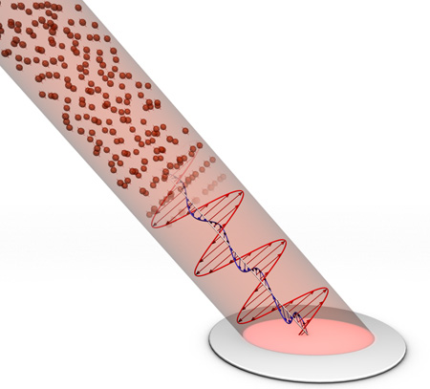
Light is electromagnetic radiation, comprising of an electric and magnetic fields. An electric field is undulating in the vertical direction and a magnetic field is undulating in the horizontal direction and both of them fluctuate perpendicularly to the direction of propagation.
Light exhibits properties of both waves and particles.
light is emitted and absorbed in tiny "packets" called photons.
Photon :
It is the elemental unit of light.
It has motion, but no mass or charge.
It is characterized by ( wavelength (λ), frequency (v) and energy (E). )
E = hv
Light is composed of packets of energy called photons
Where:
h is Planck's constant = 6.626 × 10 ⁻³⁴ joule·s
c is the speed of light = 2.998 × 10⁸ m/s

Slide 5
The law of conservation of energy
According to this law:-
Energy can never be created or destroyed.
Although energy can never be created or destroyed, it can be transformed into new forms.
In other words, the total amount of energy available in the universe remains constant and can never increase or decrease.
Energy = hv = KT = ½ mv²
Light energy is capable of causing heating, mechanical effects and chemical reactions.

Slide 6
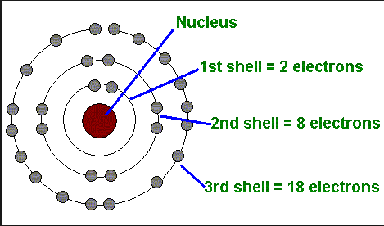
Bohr model of the atom :
The atom is a basic unit of matter that consists of a dense central nucleus surrounded by a cloud of negatively charged electrons.
In atomic physics, the Bohr model, introduced by Niels Bohr in 1913, depicts the atom as a small, positively charged nucleus surrounded by electrons that travel in orbitals around the nucleus.
Niels Henrik David Bohr
Bohr model of the atom
1885 - 1962

Slide 7
He suggested that electrons could only have certain classical motions:
Electrons in atoms are free to move around the nucleus.
The electrons can only move stably, without radiating, in certain orbitals (called by Bohr the "stationary orbits) at a certain discrete distances from the nucleus.
These orbitals are associated with definite energies and are also called energy shells or energy levels. In these orbitals, the electron's acceleration does not result in radiation and energy loss.
Electrons can only gain and lose energy by jumping from one allowed orbital to another, absorbing or emitting electromagnetic radiation with a frequency (ν ) determined by the energy difference of the levels according to the Planck relation:

Slide 8
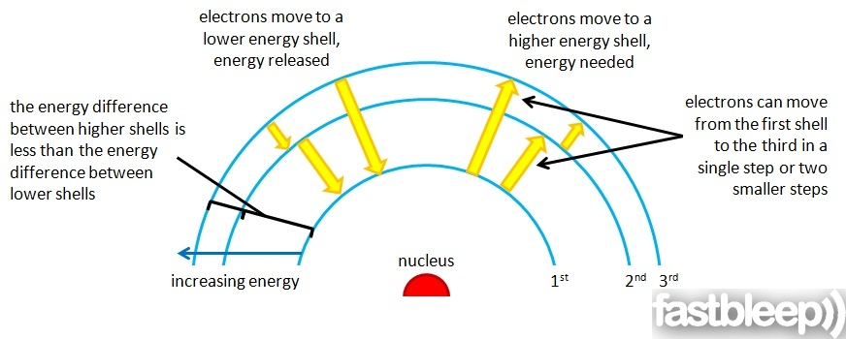
Energy Levels of the atoms:
Energy levels, also called energy shells. Electrons fill the shells starting at the lowest energy levels closest to the nucleus and then filling the outer shells. When the electrons are in their lowest energy configuration this is called “ground state.” Introducing energy to the system can temporarily excite an electron into a higher shell. They must always absorb fixed amounts of energy as electrons cannot exist between energy potentials. However these energy levels are not evenly spaced out. the absorption, will only take place if there is an energy level to which the electron can move with that amount of extra energy.
Energy is released when the electron drops back down a level although often not in the same form. For example if an atom absorbs wavelength of light that excites it two energy levels higher in one go it may drop back one energy level at a time and each time release light at a different wavelength to the one it absorbed (known as fluorescence).

Slide 9
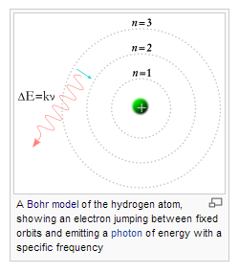

Slide 10
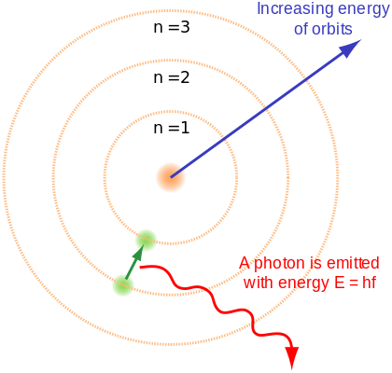
An electron farther from the nucleus has higher potential energy than an electron closer to the nucleus

Slide 11
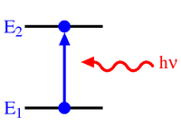
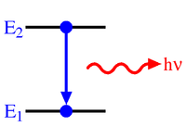
For an electron to jump to a higher level state, the atom must receive energy from the outside. This can happen through a variety of mechanisms such as inelastic or semielastic collisions with other atoms and absorption of energy in the form of electromagnetic radiation (e.g., light). Likewise, when an electron drops from a higher state to a lower state, the atom must give off energy, either as kinetic activity (nonradiative transitions) or as electromagnetic radiation (radiative transitions).
An increase in energy level from E₁ to E₂ resulting from absorption of a photon represented by the red arrow, and whose energy = h ν
A decrease in energy level from E₂ to E₁ resulting in emission of a photon represented by the red arrow, and whose energy = h ν

Slide 13
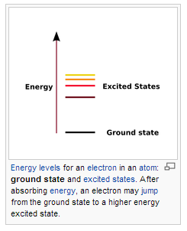
The ground state of a quantum system is its lowest-energy state; the energy of the ground state is known as the zero-point energy of the system. An excited state is any state with energy greater than the ground state.
The lifetime of a system in an excited state is usually short, spontaneous or induced emission of a quantum of energy usually occurs shortly after the system is promoted to the excited state, returning the system to a state with lower energy (a less excited state or the ground state). This return to a lower energy level is often loosely described as decay and is the inverse of excitation.

Slide 14
Absorption :
In physics, absorption of electromagnetic radiation is the way in which the energy of a photon is taken up by matter, typically the electrons of an atom. Thus, the electromagnetic energy is transformed into internal energy of the absorber, for example thermal energy.
By absorbing a photon, an electron can move from lower energetic orbit (lower energy state: ground state ) to a more energetic orbit (higher energy state: excited state) around the nucleus leading to excitation of atom, the energy of the photon must correspond exactly to the energy difference between two levels of the atom ( E₂ – E₁ ).
The rate of absorption is proportional to the radiation intensity of the light, and also to the number of atoms currently in the ground state, N₁
E₂
E₁

Slide 15
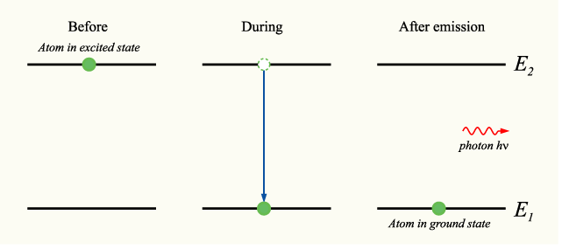
Spontaneous emission :
If a collection of atoms are in the excited state with energy E₂, spontaneous decay events to the lower lying level (e.g., the ground state) with energy E₁ will occur at a rate proportional to N₂ (the number of atoms in the excited state). The energy difference between the two states (ΔE₂₁ )is emitted from the atom as a photon of frequency ν₂₁ as given by the frequency-energy relation.
The photons are emitted randomly and there is no fixed phase relationship between photons emitted from a group of excited atoms; in other words, spontaneous emission is incoherent.
Spontaneous emission of light or luminescence is a fundamental process that plays an essential role in many phenomena in nature and forms the basis of many applications, such as fluorescent tubes, older television screens (cathode ray tubes), plasma display panels.

Slide 16
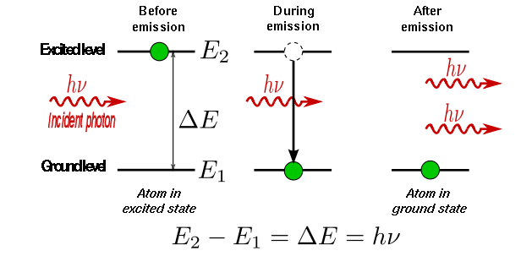
Stimulated emission :
Is the process by which an atomic electron (or an excited molecular state) interacting with an electromagnetic wave of a certain frequency ( a frequency ν₂₁ corresponding to the energy gap ΔE of the excited state to ground state transition) may drop to a lower energy level, transferring its energy to that field. A new photon created in this manner has the same phase, frequency, polarization, and direction of travel as the photons of the incident wave. The original photon is not absorbed by the atom, and so the result is two photons of the same frequency and the same phase and direction (In other words, the two photons are coherent ). This process is known as stimulated emission. It is this property that allows optical amplification, and the production of a laser system. .
The rate at which stimulated emission occurs is proportional to the number of atoms N₂ in the excited state, and the radiation density of the light.

Slide 17
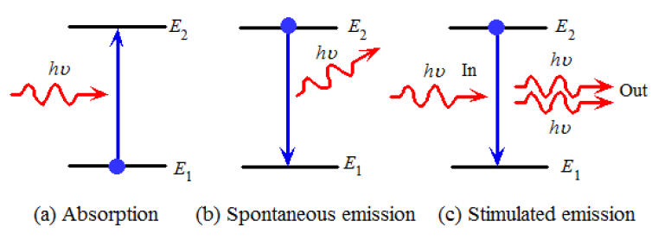

Slide 18
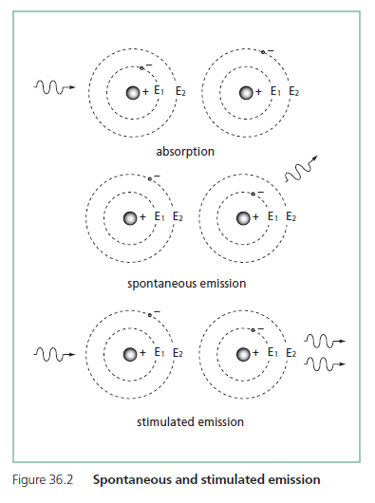

Slide 20
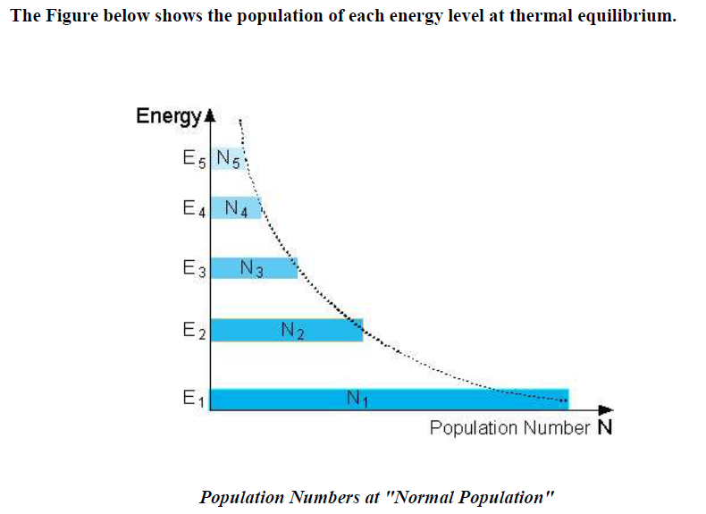
Boltzmann distributions and thermal equilibrium :
We saw that in a thermal equilibrium : N1 > N2 > N3 > N4 > N5
Thus, the population numbers of higher energy levels are smaller than the
population numbers of lower ones. This situation is called "Normal Population“. and this is the normal state of the system..

Slide 21
Boltzmann distributions :
Assume there are a group of N atoms forming a laser medium., each of which is capable of being in one of two energy states, either
The ground state, with energy E₁; or
The excited state, with energy E₂, with E₂ > E₁.
The number of these atoms which are in the ground state is given by N₁, and the number in the excited state N₂. Since there are N atoms in total,
The energy difference between the two states, given by
determines the characteristic frequency ν₁₂ of light which will interact with the atoms; This is given by the relation :
h being Planck's constant.
If the group of atoms is in thermal equilibrium, it can be shown from thermodynamics that the ratio of the number of atoms in each state is given by the Boltzmann factor:
where T is the thermodynamic temperature in kelvins (K) of the group of atoms, and k is Boltzmann's constant = 1.38 ×10ˉ²³ [Joule/K]. :

Slide 22
When in thermal equilibrium, then, it is seen that the lower energy state is more
populated than the higher energy state, and this is the normal state of the system.
As T increases, the number of electrons in the high-energy state (N₂) increases, but N₂ never exceeds N₁ for a system at thermal equilibrium; rather, at infinite temperature, the populations N₂ and N₁ become equal.
In other words, a population inversion (N₂/N₁ > 1) can never exist for a system at thermal equilibrium.
To achieve population inversion therefore requires pushing the system into a non-equilibrated state.
We may calculate the ratio of the populations of the two states at room temperature (T ≈ 300 K) for an energy difference ΔE that corresponds to light of a frequency corresponding to visible light (ν ≈ 5×10¹⁴ Hz).
In this case ΔE = E₂ - E₁ ≈ 2.07 eV, and kT ≈ 0.026 eV. Since E₂ - E₁ ≫ kT, it follows that the argument of the exponential in the equation above is a large negative number, and as such N₂/N₁ is vanishingly small; i.e., there are almost no
atoms in the excited state.

Slide 23
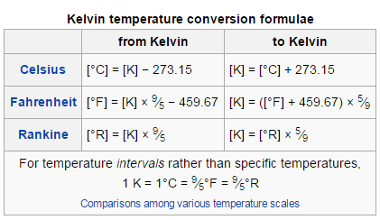
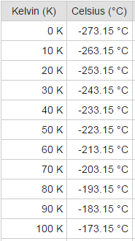
absolute zero (0 K) equivalent to −273.15 °C and (−459.67 °F).
Kelvin to Celsius conversion table

Slide 24
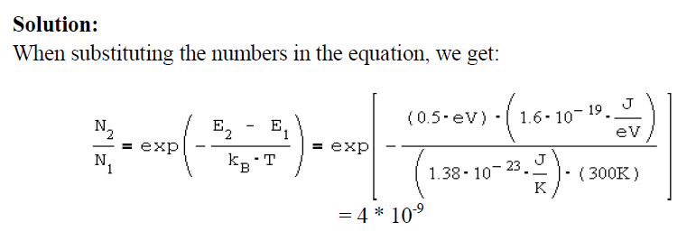

Slide 25
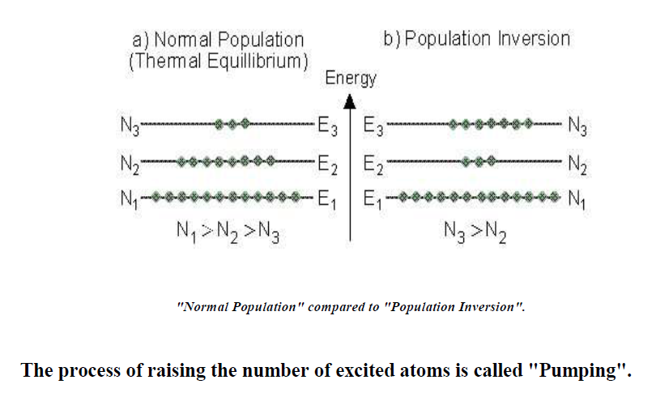
Population inversion :
In physics, a population inversion occurs when a system (such as a group of atoms or molecules) exists in a state with more members in an excited state than in lower energy states (ground state). The concept is of fundamental importance in laser science because the production of a population inversion is a necessary step in the generation of laser.
In population inversion, at least one of the higher energy levels has more atoms
than a lower energy level.
An example is described in the Figure below. In this situation there are more atoms (N3) in an higher energy level (E3), than the number of atoms (N2) in a lower energy level (E2).

Slide 26
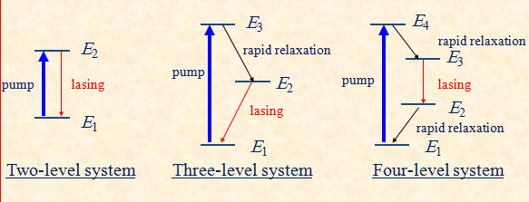
Generating a population inversion :
How can a population inversion be created?
1) Atoms are pumped (excited ) into the highest of energy levels.
2) Spontaneous de-excitation from the pump level to the metastable level.
3) Laser emission between the metaestable level and the ground state.
4) Alternatively, if a fourth excited level is included as lower laser level, which
relaxes fast into ground state, lasing is favored since the bottom level involved is
empty.
Notes:
A true two-level system cannot produce a population inversion
A three-level system must be pumped harder than a four-level system – that is, more molecules must be pumped into the excited level to produce lasing

Slide 27
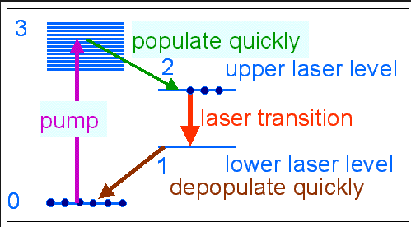

Slide 28
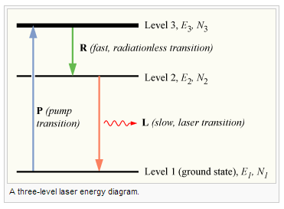
Three Level Laser :
A schematic energy level diagram of a laser with three energy levels is the figure below.
The two energy levels between which lasing occur are: the lower laser energy level (E1), and the upper laser energy level (E2).
To achieve lasing, energy must be pumped into the system to create population inversion. So that more atoms will be in energy level E2 than in the ground level (E1). Atoms are pumped from the ground state (E1) to energy level E3.They stay there for an average time of 10ˉ⁸ sec,
and decay (usually with a non-radiative transition) to the metastable energy level E2.
Since the lifetime of the metastable energy level (E2) is relatively long (of the order
of 10ˉ³ sec, many atoms remain in this level.
If the pumping is strong enough, then after pumping more than 50% of the atoms will be in energy level E2, a population inversion exists, and lasing can occur.
upper lasing state
N₂ > N₁
population inversion
E₂ – E₁ = hν₁₂
lower lasing state
Example:
Ruby laser

Slide 29
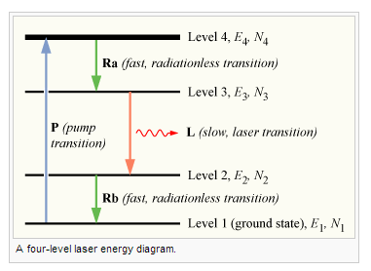
Four Level Laser :
The schematic energy level diagram of a four level laser is shown in the figure below.
Compared to the equivalent diagram of a three level laser, there is an extra energy level
above the ground state. This extra energy level has a very short lifetime.
The pumping operation of a four level laser is similar to the pumping of a three level laser. This is done by a rapid population of the upper laser level (E3), through the higher energy
level (E4).
To create population inversion, there is no need to pump more than 50% of the atoms to the
upper laser level.
Advantages of four level lasers Compared to three level lasers:
• The lasing threshold of a four level laser is lower.
• The efficiency is higher.
• Required pumping rate is lower.
• Continuous operation is possible.
upper lasing state
N₃ > N₂
population inversion
E₃-E₂ = hν₃₂
lower lasing state
Example:
most practical lasers are of this type
He-Ne laser,
Nd:YAG laser
Dye Lasers

Slide 30
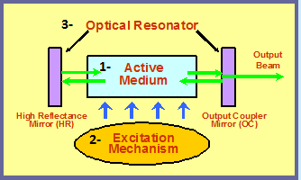
Laser Generation:
Requirements for Laser Action :

Slide 31
Requirements for Laser Action
fast
Metastable state
slow
Population inversion
slow relaxation
efficient pumping
Fast relaxation

Slide 32
Laser generation :
During the operation of a laser, all three light-matter interactions are taking place (Absorption, Spontaneous emission, Stimulated emission ). Initially, atoms are energized from the ground state to the excited state (Absorption ) by a process called pumping. Some of these atoms decay via (Spontaneous emission), releasing incoherent light as photons of frequency ν. These photons are fedback into the laser medium, usually by an optical resonator. Some of these photons are absorbed by the atoms in the ground state, and the photons are lost to the laser process. However, some photons cause (Stimulated emission) in excited-state atoms, releasing another
coherent photon. In effect, this results in optical amplification.
If the number of photons being amplified per unit time is greater than the number of photons being absorbed, then the net result is a continuously increasing number of photons being produced; the laser medium is said to have a gain of greater than unity.
Eventually so many identical photons are stimulated that the chamber cannot contain the energy and so the photons of a particular wavelength are ejected through the semi-permeable mirror producing amplified light (Coherent, Collimated, Monochromatic, Unidirectional light ).

